Slide 1
Project 3: Troubles Data Visualization Pat Martin Dean Tolmachoff Jonathan Rivera

Slide 2
The Troubles
What were “The Troubles”?
Civil conflict in Northern Ireland from late 1960’s to 1998
Primarily a political issue based upon separation from the UK. “Protestants” vs. “Catholics”.
Data Visualization of Deaths
Used JSON file created by Pat and Meggie from Project 2
Mapping a visual of all deaths related to the Troubles conflict from 1969 to 2001

Slide 3
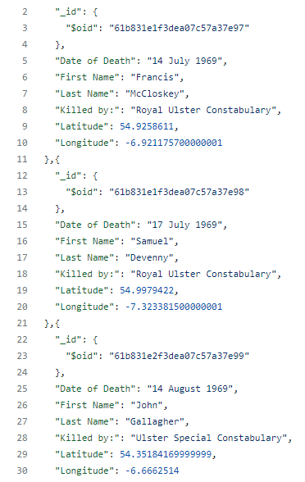
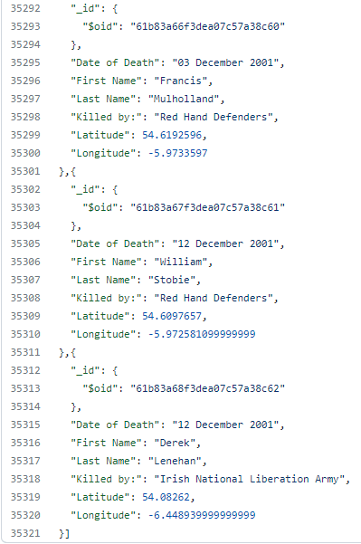
JSON DB

